Slide 1


PROJECT PRESENTATION
NAM DINH KHUONG TRAN

Slide 2
SOMETHING ABOUT ME
INTRODUCTION
MY PROJECT
Name: Nam Tran - Henry
Major: Computer Science
Hobbies: Coding, playing computer games, and listening to music
Plan: Graduate next spring, then transfer to the University of Maryland, College Park
Project idea: I loved solving puzzle games when I was a child
Project name: Sliding Puzzle

Slide 3
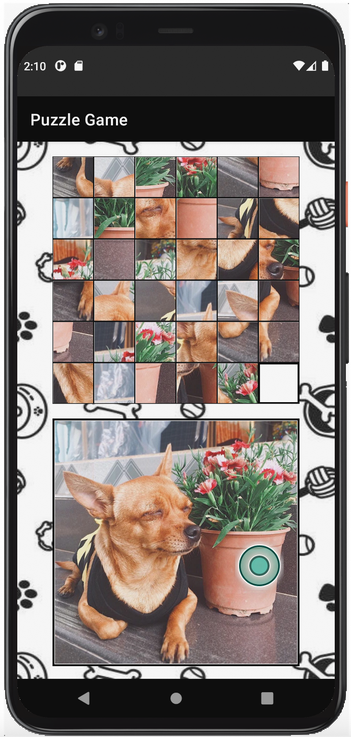
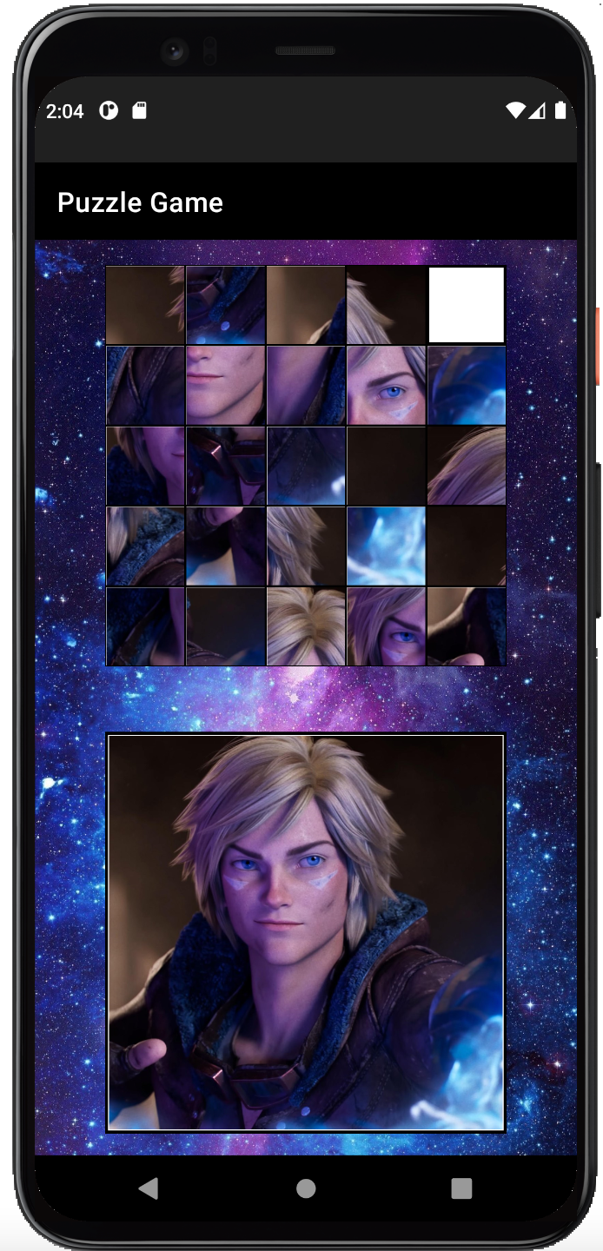
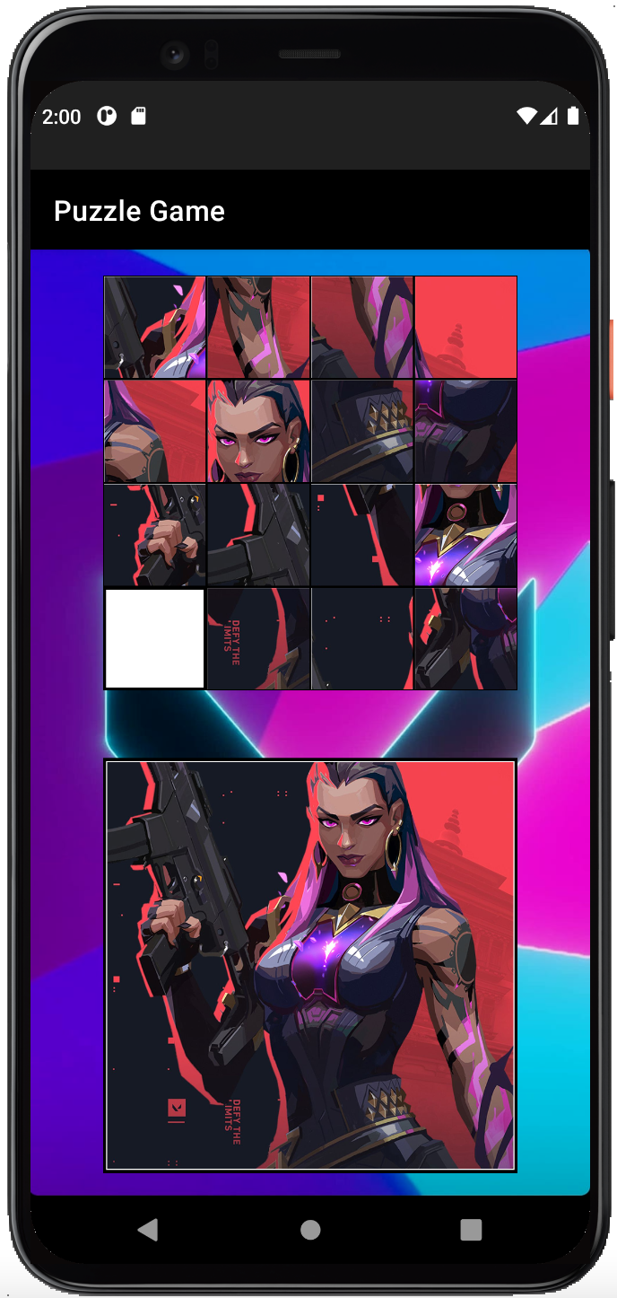
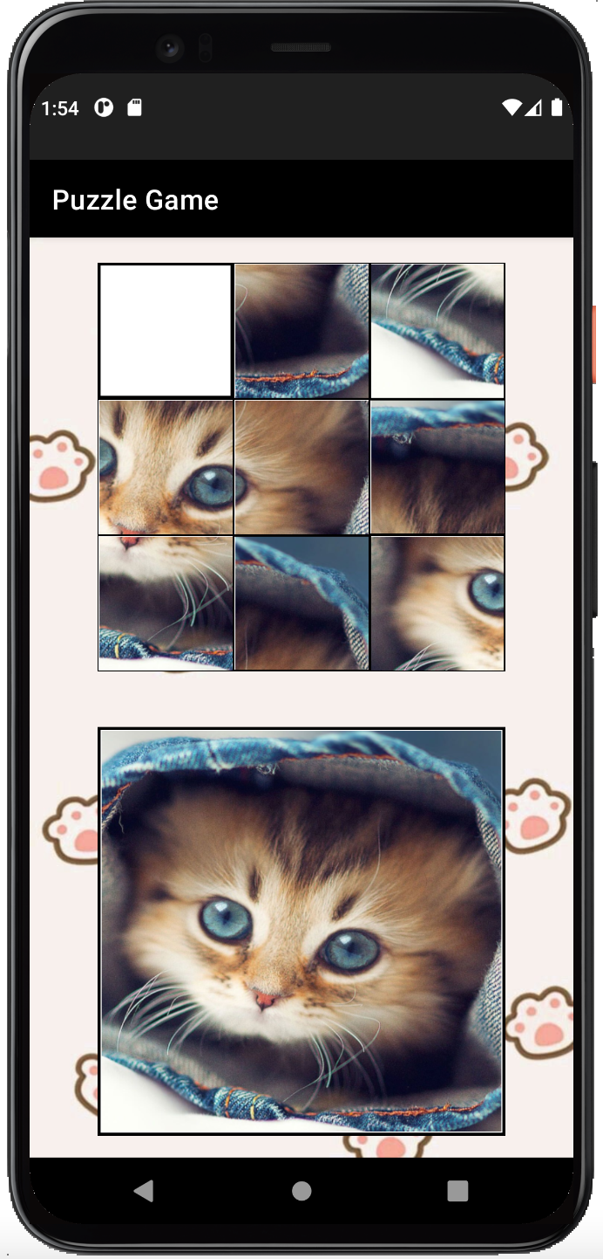
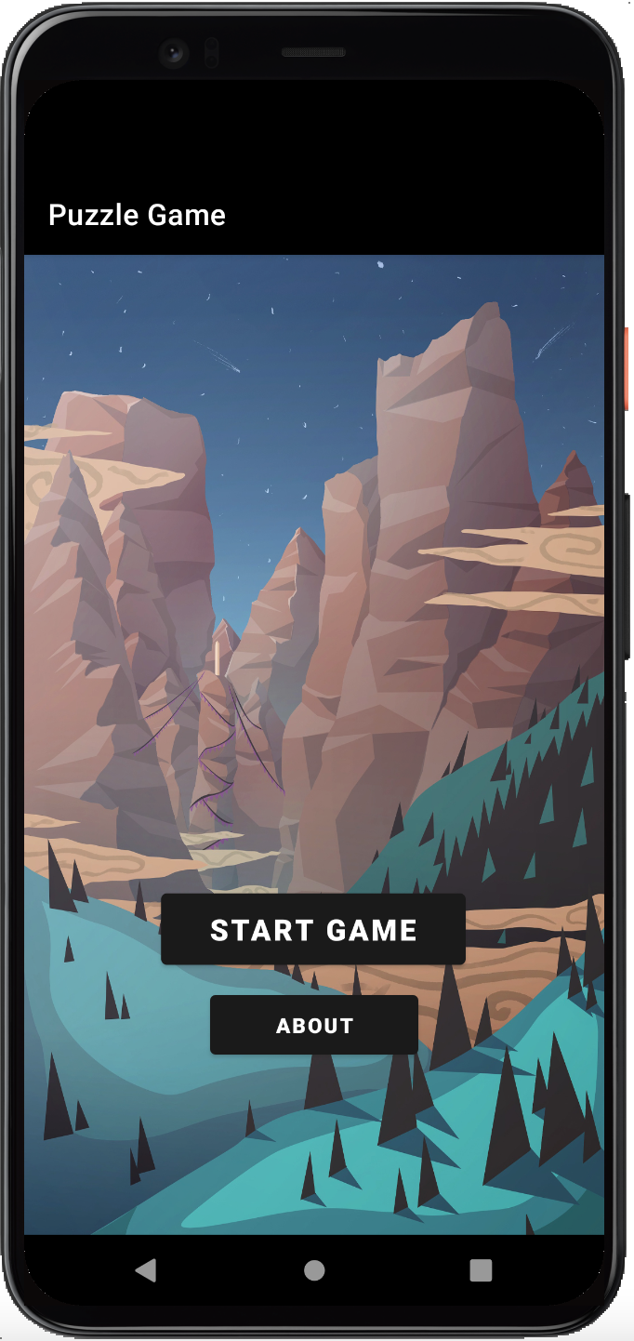
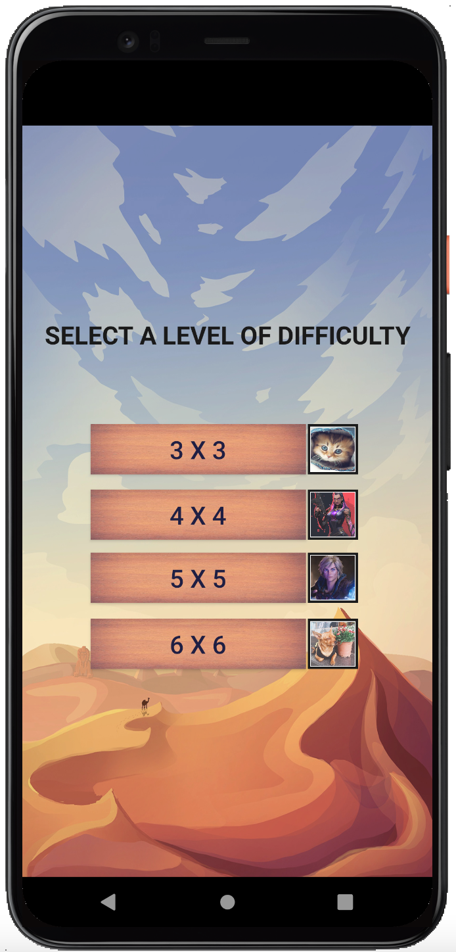

Level 5x5
Level 6x6
Level 4x4
Level 3x3
Welcome Screen
WIREFRAMES
5
4
3
2
1

Slide 4
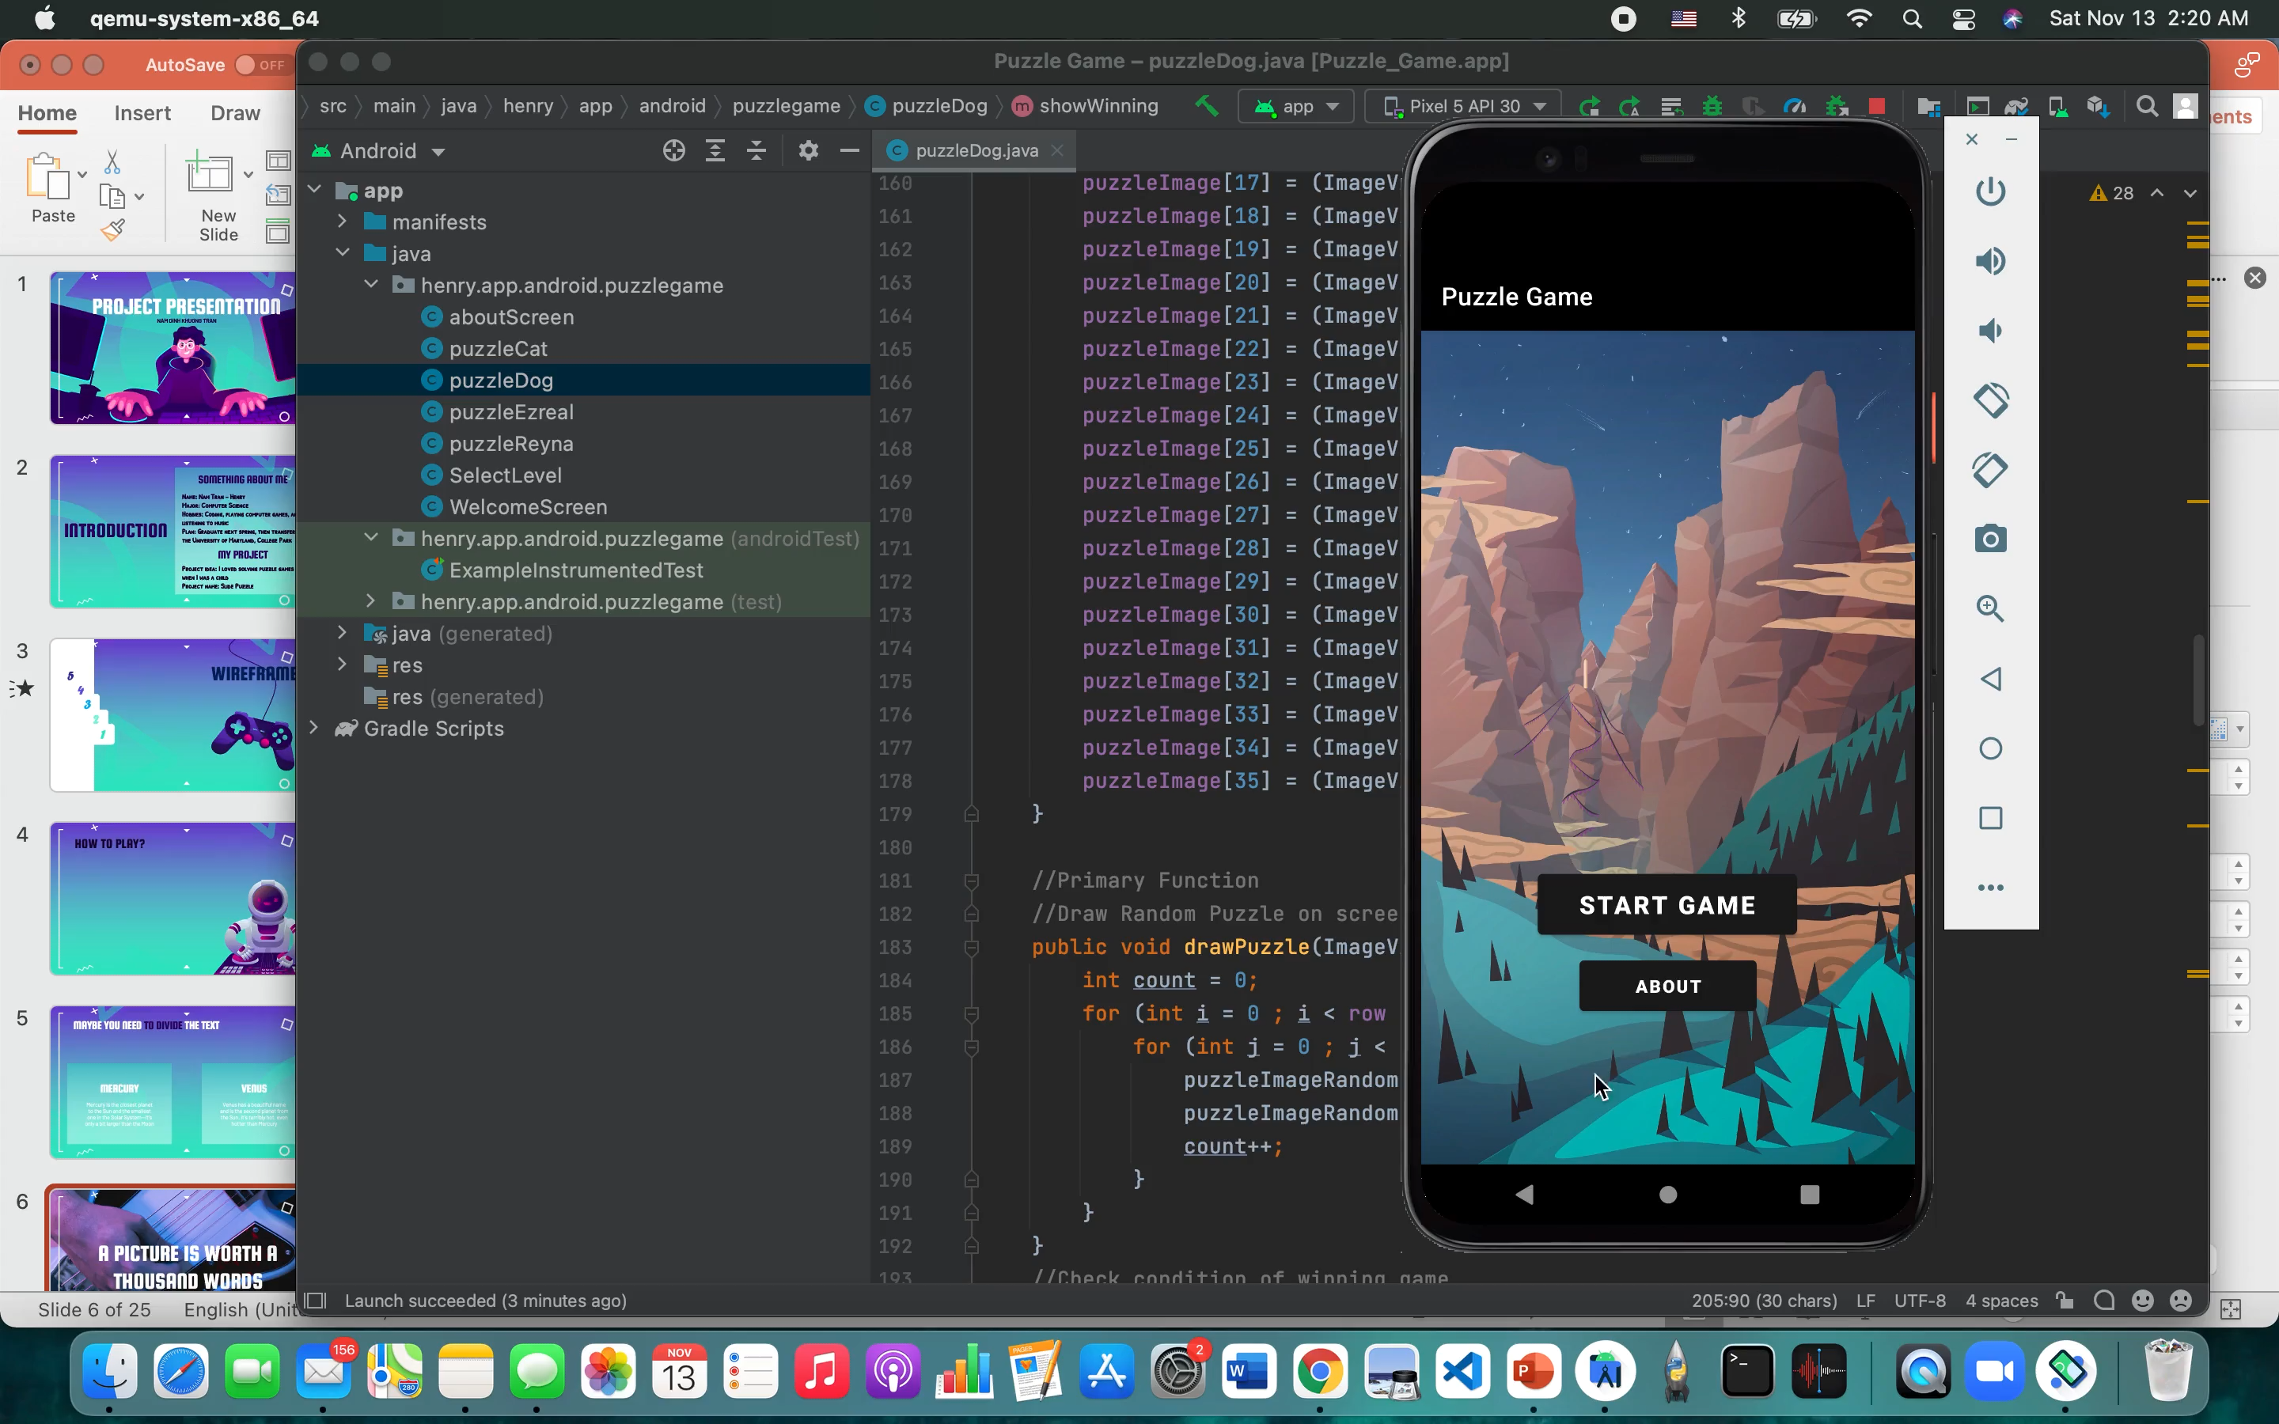
HOW TO PLAY?

Slide 5

THANKS!
Do you have any questions?
ktran58@students.pgcc.edu

